Slide 1
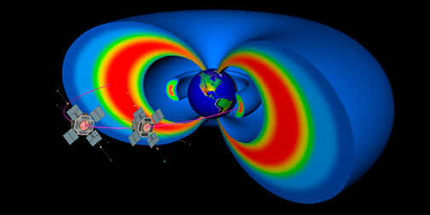
Extreme Exploration:
Journey to Earth’s Van Allen Radiation Belts
Van Allen Probes
The Johns Hopkins University Applied Physics Lab

Slide 2
New Words to Impress Your Friends and Family
Magnetosphere
Magnetotail
Van Allen Radiation Belts
Geomagnetic Storm
Aurora
Coronal Mass Ejection (CME)
Radiation
Notes:
Before we get started with our story, lets look at some new words that we will be using along the way. Has anyone ever heard of any of these words? Does anyone have a guess what they might mean? (Accept all answers at this time).

Slide 3
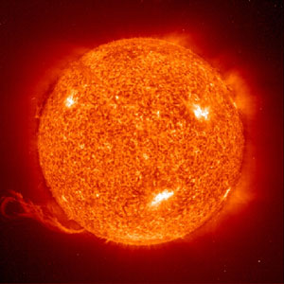
Notes:
And we need to talk a little about our nearest star, (who knows what that is?) and our relationship with it. How does the sun affect us? (light, heat, helps things grow, accept all reasonable answers.) It also affects us in ways that you might not have guessed.

Slide 4
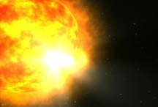
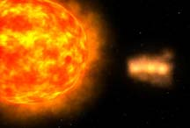
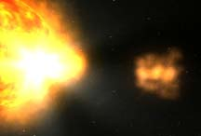
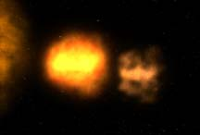
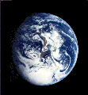
Kaboom!
There are sometimes huge explosions on the surface of the Sun. These eruptions include solar flares and coronal mass ejections (CMEs). They can send energy and tiny particles flying toward Earth at great speeds.
Notes:
Explain that even though the solar particles are very small, they can be very dangerous because they are moving so quickly.

Slide 5
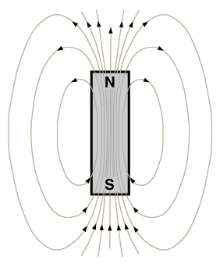
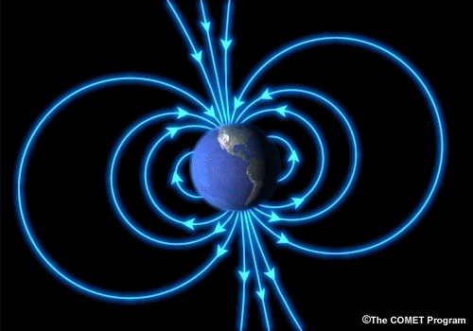
Magnetic Earth
Have you ever played with a magnet? The Earth has a magnetic field, just like a bar magnet. Earth's magnetic field forms a protective space called the magnetosphere. Luckily for us, the magnetosphere provides protection from direct blasts of the Sun's most violent explosions.
Notes:
Ask students to break down the word magnetosphere. Many will recognize the word "magnet." Teacher may want to pause here to demonstrate magnetic field lines by placing a piece of paper over a bar magnet and sprinkling iron filings over the paper. If magnets are available, teacher may also want to let students feel the magnetic force between them and then have them describe how this relates to the relationship between the Sun and Earth. A few resources for more information in addition to the RBSP website (http://rbsp.jhuapl.edu) include NASA's websites: http://stargazers.gsfc.nasa.gov/educators/educators.htm and http://sunearth.gsfc.nasa.gov/sunearthday/2003/educators_guide2003/index6.html

Slide 6
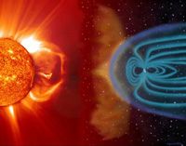
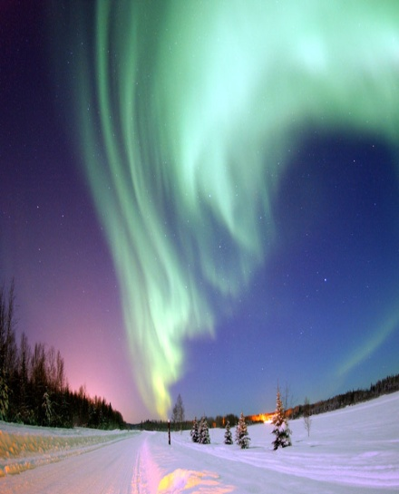
When the Sun Sneezes the Earth Catches a Cold
The Sun and Earth have a very close relationship. Particles from the Sun travel along Earth’s magnetic field lines and create a beautiful light show called the Aurora. People that live in the far northern and southern regions of Earth see them most when the Sun is most active, about every 11 years.
Large explosions on the Sun, (CMEs) can cause big changes around Earth. When this happens we call it a geomagnetic storm. These storms can affect our spacecraft, satellites, and the safety of astronauts.
Notes:
Geomagnetic storms can wipe out power grids on Earth, damage satellites, and endanger the lives of astronauts. Scientists and engineers are continually working to better understand the intricate relationship between the Sun and Earth. Talk about the pictures, especially magnetic field lines and the magnetosphere directing the CME around the Earth (top left).

Slide 7
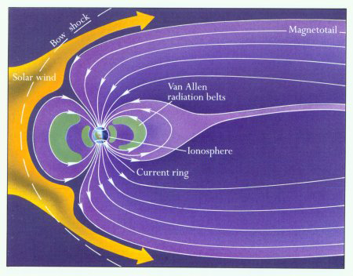
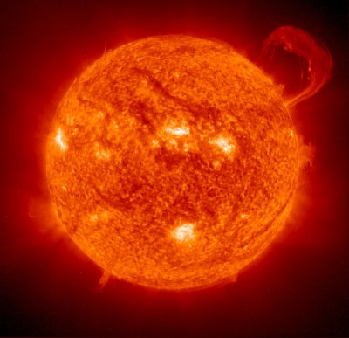
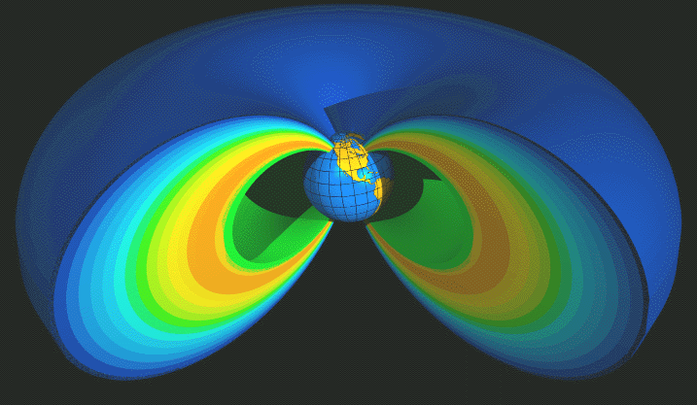
The Van Allen Radiation Belts
The Sun also affects a place called the Van Allen radiation belts. The belts are near Earth, inside the magnetic field. They look like two giant donuts surrounding our planet. Particles from the Sun get past the magnetic field by coming in through the tail of the magnetosphere which is called the magnetotail. Sometimes when the particles get in, they get trapped and can’t get out.
and get caught inside two donut shaped regions called the Van Allen radiation belts.
Particles from the Sun
enter the magnetosphere through the magnetotail
Notes:
Review magnetosphere and magnetotail using pictures. Point out the radiation belt in last picture. Mention this picture only shows one, but there are two. May want to point out the two belts, colored in green, in middle picture and talk about their location. May want to point out solar wind and discuss what that is.

Slide 8
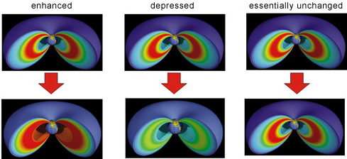
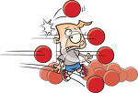
A Radiation Belt Mystery
Sometimes after a solar storm, radiation (the high speed particles) inside the Van Allen belts gets really intense, (like a super high speed dodge ball game). Other times after a similar storm, the radiation decreases, and other times it stays the same. Scientists want to understand why and how this is happening.
iClipArt
Notes:
The bottom pictures represent the radiation levels in the radiation belts following a solar storm. The left pictures indicate an increase in radiation, the middle set represents a decrease in radiation, and the right set represents no change. Ask if anyone has ever heard the word radiation. Explain that in this case, radiation means that the particles are moving close to the speed of light. “Intensity” increase means an increase in both the number and energy level of these protons, ions, and electrons.

Slide 9
Extreme Environment
The Van Allen radiation belts can be dangerous, especially for a satellite, spacecraft or an astronaut during a geomagnetic storm. It can damage the electronics of a satellite or make an astronaut very sick if precautions aren’t taken.
Twin spacecraft called the Van Allen Probes were built to go into this extreme place to collect information. Knowing about tornados and hurricanes helps to protect us here on Earth. In the same way, the new things scientists find out about space weather will help protect technology and people that are in the radiation belts.
Notes:
Sometimes after a CME, the radiation belts can get extremely dangerous. The particles speed up to incredibly high velocities and increase in number too. A comparison might be if you were riding your bike in the middle of a super highway, trying not to get be hit by one of the many dangerous fast moving cars. Many spacecraft have the ability to go into a safe mode during extreme space weather, and astronauts protect themselves by not going out when a solar storm is predicted.

Slide 10
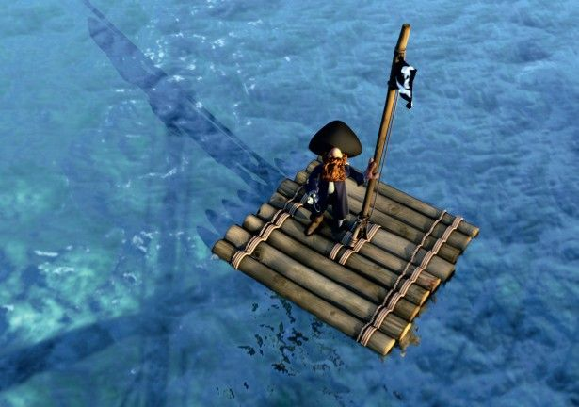
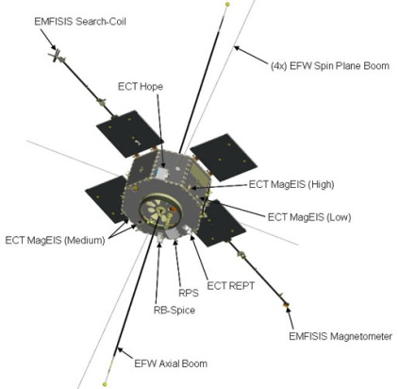
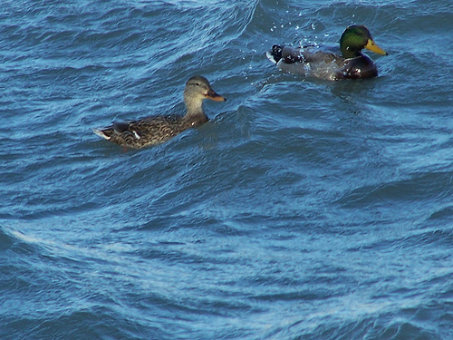
Why Are There Two Identical Spacecraft?
Notes:
Imagine you are alone on a raft in the ocean. You feel the raft rising and falling with the motion of the ocean. Is the entire ocean rising and falling? Is it just a wave passing by? Without having something else to compare your motion to, it would be difficult to tell. Now imagine there is another raft a short distance away and that raft is rising as yours is falling, just as the ducks are in this picture. Would this additional information be helpful in determining why your raft was moving and help you more clearly understand your surroundings? Why?

Slide 11
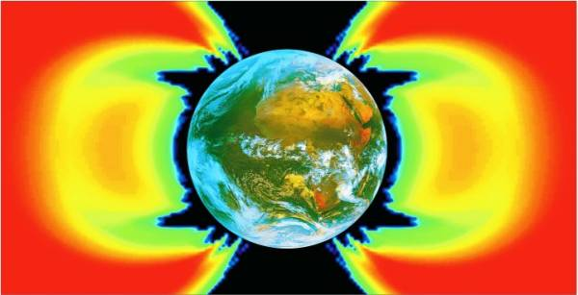
Super Tough Twins
The Van Allen Probes won’t switch off or into “safe mode” when the going gets tough like satellites often need to do.
copyright © ONERA 1996-2006
These probes were designed to be extra tough. They operate in this dangerous environment, studying the conditions that could destroy other spacecraft.
Notes:
11
Two protective engineering methods being used include the application of a thick layer of aluminum coating on the exterior of the probes and the shielding of solar panels with a layer of glass. Some have wondered why we don't apply this extra layer of protection to all spacecraft. Engineers try to estimate the amount of protective coating that is needed for each spacecraft according to what it may encounter on the mission. If they estimate too low the spacecraft may be damaged. If they estimate too high it increases the cost unnecessarily. The information gained during the RBSP mission will help us to understand the exact amount of protection that is needed each time we build a craft that will encounter the extreme conditions of the Van Allen Radiation Belts.

Slide 12
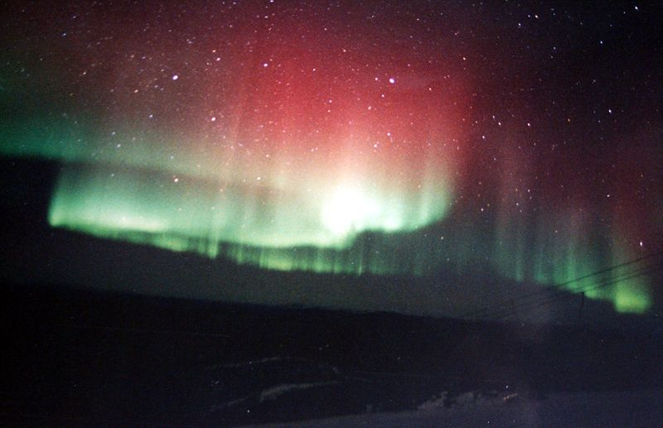
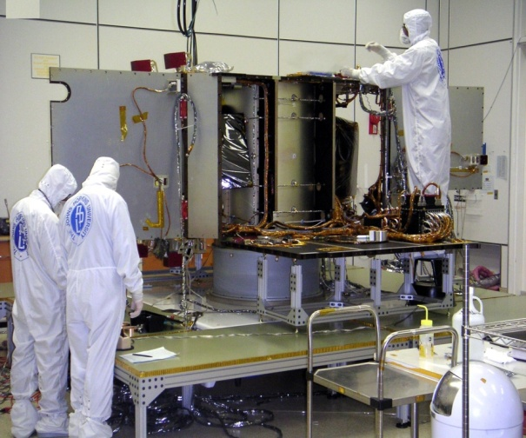
Why Do We Care?
What we find out will help engineers design better protection for spacecraft that operate there. Examples of these spacecraft are satellites that help our cell phones and TVs work.
Solar storms
Railroad
systems
Satellite
Technology
Communication
Systems
Radio
Power
Transmission
Lines
Global
Navigation
Emergency
Response
Systems
Air Travel
TV and Cell Phones
What we find out will help people more easily predict bad “storms” in the radiation belts. This will help to keep our satellites and astronauts safe.
Notes:
12
Currently we estimate the protection a spacecraft needs, and usually add 2-3 times more protection. Sometimes it enough, and other times its not and we lose a satellite. With more knowledge, we would know how to get it just right every time. The risk of losing a craft would be decreased AND we would save money by not possibly over protecting the craft and therefore adding extra unnecessary weight

Slide 13
This Mission is Important to All of Us
Understanding the mysteries of Earth’s Van Allen radiation belts is important to our modern way of life.
Protecting our technologies and the health of the people who work with them.
Exploring the mysteries above our heads.
Influencing the future.

Slide 14
Your Turn!
How Many New Words Can You Remember?
Magnetosphere
Magnetotail
Van Allen Radiation Belts
Geomagnetic Storm
Aurora
Coronal Mass Ejection (CME)
Radiation
Notes:
Match the word with the picture

Slide 15
Extreme Exploration:
Journey to Earth’s Van Allen Radiation Belts
Van Allen Probes
Find out More!
Play online games, learn a new running game,
pick a scientist to answer your questions, and more at:
http://vanallenprobes.jhuapl.edu/education/

